Slide 1

One-way repeated measures ANOVA

Slide 2
In a one-way repeated measures ANOVA design each subject is exposed to two or more different conditions, or measured on the same continuous scale on three or more occasions. It can also be used to compare respondents’ responses to two or more different questions or items.

Slide 3
One-way repeated measure ANOVA and paired-samplest-test are both appropriate for comparing scores in before and after designsfor the same participants.
•Repeated-measures designs are considered an extension of the paired-samples t-test when comparisons between more than two repeated measures are needed.

Slide 4

Assumption #1:Your dependent variable should be measured at the continuous level (i.e., they are interval or ratio variables).
Assumption #2: Your independent variable should consist of at least two categorical, "related groups" or "matched pairs". "Related groups" indicates that the same subjects are present in both groups. The reason that it is possible to have the same subjects in each group is because each subject has been measured on two occasions on the same dependent variable

Slide 5
Assumption #3: There should be no significant outliers in the related groups.
Assumption #4: The distribution of the dependent variable in the two or more related groups should be approximately normally distributed
Assumption #5: Known as sphericity, the variances of the differences between all combinations of related groups must be equal.

Slide 6
Normally, the Wilk's lambda test is the one to be used, but it may not always be the best choice. Pillai's trace is also used quite often because of its powerfulness and robustness.
Please note that for the Roy's largest root test, a lower bound estimate of the probability of F is given, therefore, if the calculated significance level is smaller than 0.05 while the results from other tests are not, we could disregard the results from Roy's largest root test

Slide 7

The sphericity assumption requires that the variance of the population difference scores for any two conditions are the same as the variance of the population difference scores for any other two conditions (an assumption that is commonly violated). This is assessed by SPSS using Mauchly’s Test of Sphericity

Slide 8
The multivariate statistics, however, do not require sphericity. You will see in our example that we have violated the assumption of sphericity, as indicated by the Sig. value of .001 in the box labelled Mauchly’s Test of Sphericity. Although there are ways to ompensate for this assumption violation, it is safer to inspect the multivariate statistics provided in the output

Slide 9


Slide 10

The Friedman test can be viewed as an alternative to a single-factor, repeated-measures analysis of variance.
The test uses data from one sample to evaluate differences among three or more treatment conditions.

Slide 11
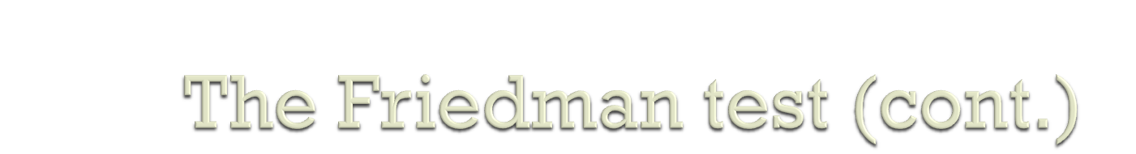
The test requires that you are able to rank order the individuals across treatments but does not require numerical scores.
The null hypothesis for the Friedman test simply states that there are no systematic or consistent differences among the treatments being compared.

Slide 12
The calculation of the Friedman statistic requires:
1. Each individual (or the individual’s scores) must be ranked across the treatment conditions.
2. The sum of the ranks (R) is computed for each treatment.
3. A formula is used to compute the Friedman test statistic which is distributed as chi-square with degrees of freedom equal to the number of treatments minus one. The obtained value must be greater than the critical value for chi-square to reject H₀ and conclude that there are significant differences among the treatments.

